Slide 1

Category Code: C5
Problem Statement Title: InvestWise AI: Intelligent Wealth Creation Platform (Investment & Stock Market Insights )
Team Name: EPIC BYTES
Institute Name: Vivekanand Education Society’s Institute of Technology

Slide 2

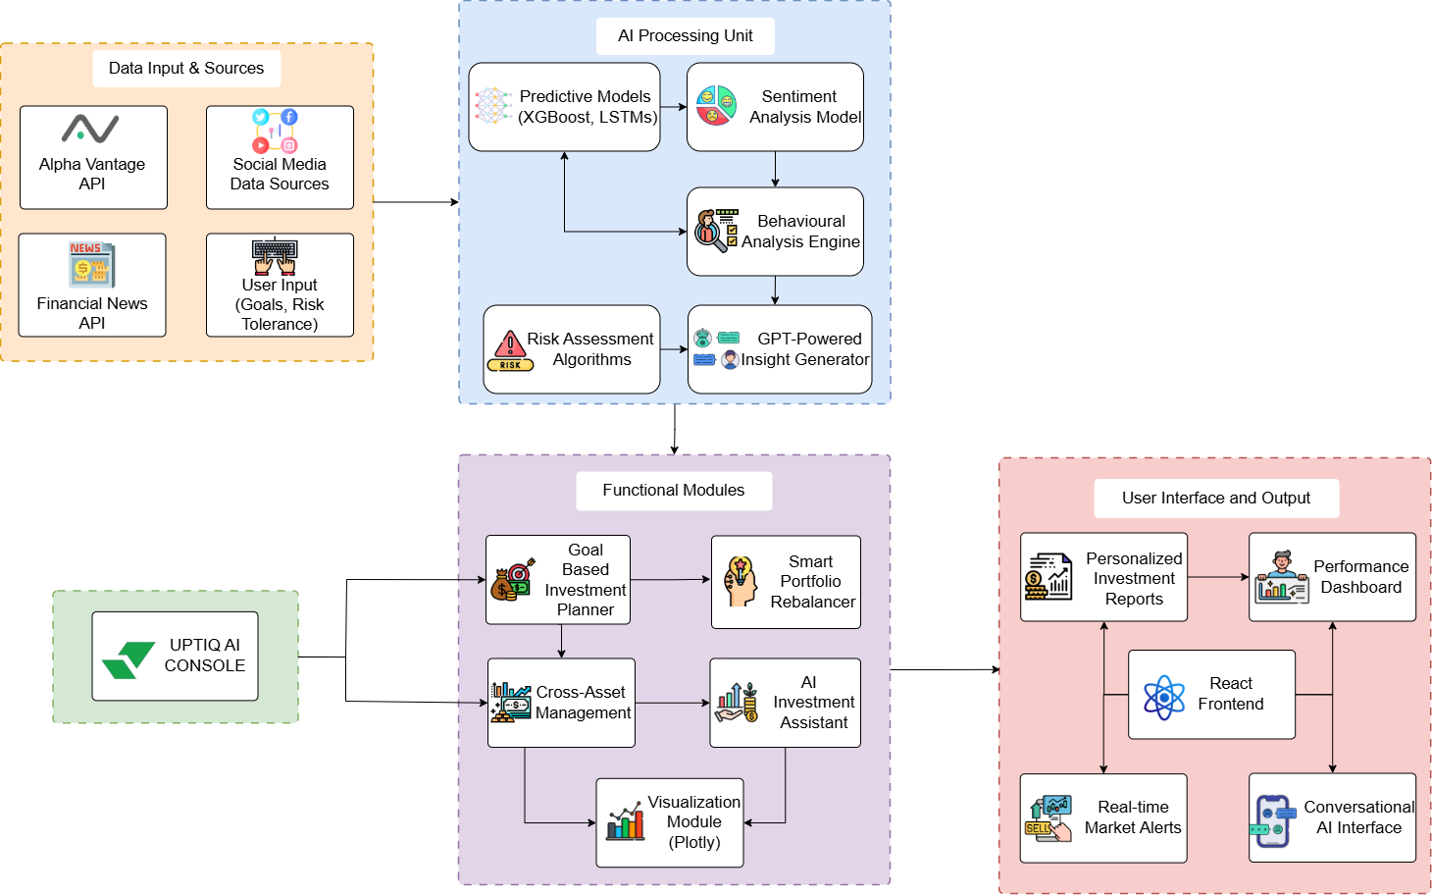
Idea / Approach details (& implemented features)
Uptiq Implementation Link:
Link

Slide 3
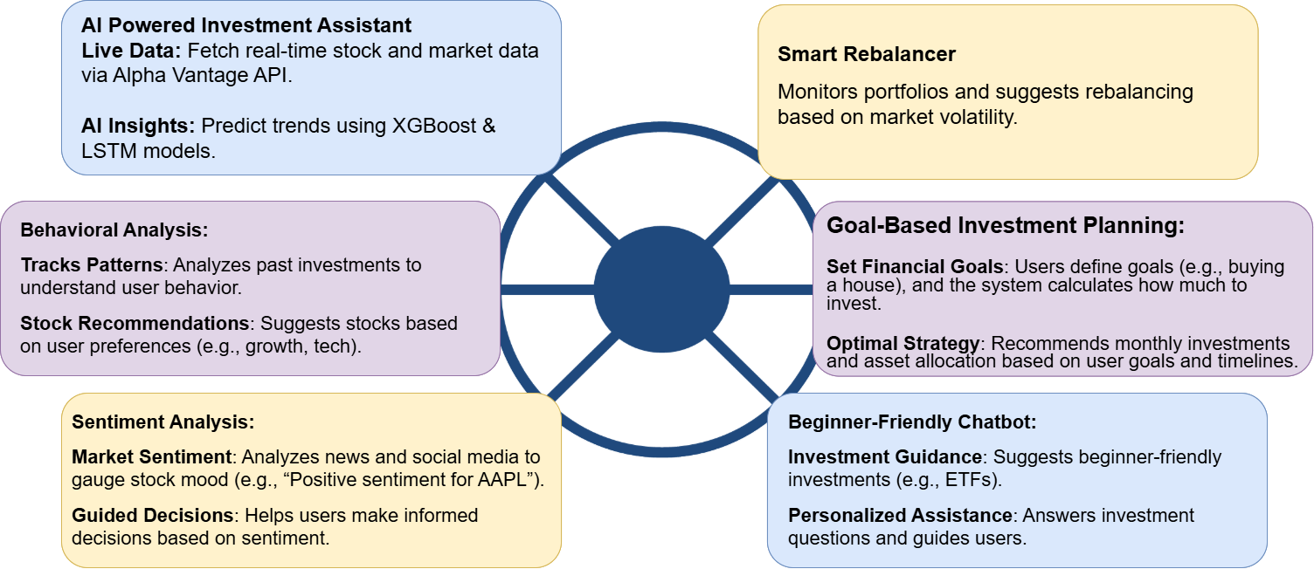
Innovation (Showstopper)

Slide 4
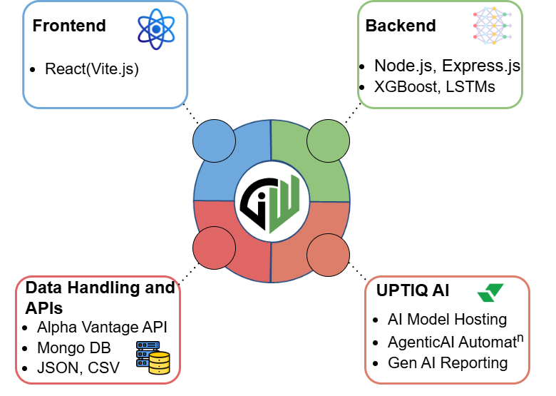
Tech Stack

Slide 5
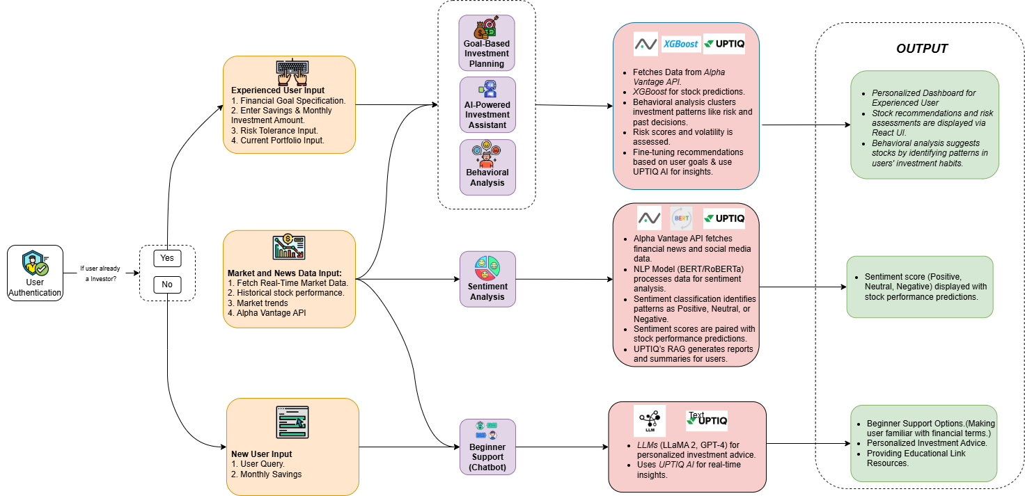
Implementation/Prototype/Use Case Diagram (screenshots)

Slide 6
In case of Uptiq category - Your Uptiq Agent (explain in detail)
UPTIQ Platform Features
Sentiment Analysis
Scans financial news and social media with BERT/RoBERTa.
Tracks trends, updates sentiment, and suggests stocks using UPTIQ Agentic AI.
Goal-Based Planning
Accesses market data via Model Hub.
Creates financial plans (e.g., $500/month for a $100k house).
Offers guidance using UPTIQ RAG Model.
Smart Rebalancer
Assesses market volatility with LSTMs.
Adjusts assets (e.g., reduce tech by 5%).
Ensures trust using UPTIQ Agentic AI.
Behavioral Analysis
Evaluates trading habits and updates clusters with K-Means.
Recommends stock picks (e.g., TSLA) via UPTIQ Agentic AI.
Investment Assistant
Gathers data via Alpha Vantage/XGBoost.
Customizes stock recommendations and adds market context.
Provides insights using UPTIQ RAG Model.
UPTIQ RAG Model Features
Personalized Summaries
Generate daily/weekly portfolio performance reports.
Provide contextual market insights.
Adapt reports based on user preferences.
Beginner Support Chatbot
Deploy conversational AI using LLMs.
Provide guided financial advice.
Generate adaptive responses based on user queries.

Slide 7
Future Objectives
Expand Data Sources Globally Integrate international market data using APIs like Quandl and FRED for diversified insights.
Enhance AI Model Accuracy Improve prediction reliability with explainable AI using advanced models like XGBoost and LSTMs.
Support Diverse Asset Classes Enable investments in cryptocurrencies, REITs, and commodities for comprehensive portfolio management.
Hyper-Personalize User Experience Offer AI-driven dashboards tailored to individual goals and risk profiles, adding gamified challenges for engagement.
Implement Real-Time Stress Testing Simulate market shocks and economic scenarios to provide proactive risk management strategies.
Introduce AI-Driven Tax Optimization Analyze gains using tax data APIs and recommend tax-efficient strategies to maximize user savings.

